Slide 1
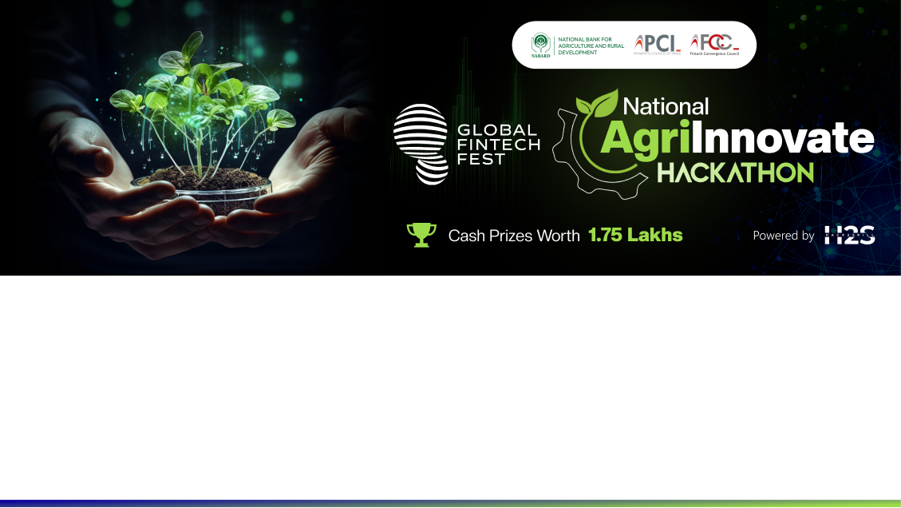
Team Details
Team name: Quantum key
Team leader name: kishore A
Problem Statement: Enhancing Input Access and Efficiency

Slide 2
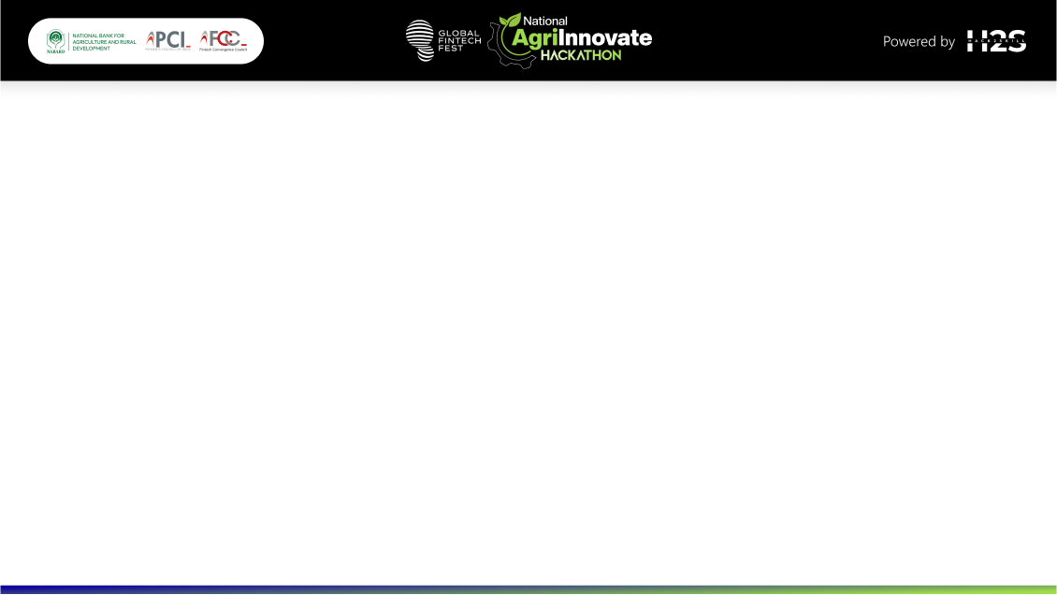
Brief about the idea
Decentralized Distribution Networks we our initiative focuses on developing decentralized distribution networks to enhance the efficiency and accessibility of agricultural inputs. We are exploring the use of drones and autonomous vehicles to deliver essential supplies such as seeds, fertilizers, and irrigation equipment to remote and underserved areas, particularly where traditional infrastructure is inadequate. This approach aims to overcome logistical barriers and ensure timely delivery of inputs.
In addition, we are establishing partnerships with local agro-dealers to serve as distribution points within these networks. By equipping agro-dealers with advanced digital tools, we enable them to effectively manage their inventory, place bulk orders, and track deliveries. This local engagement helps streamline the supply chain and improves the availability of inputs at the community level.
Furthermore, we are empowering local farmer cooperatives and groups to handle input distribution within their regions. This community-based model not only reduces transportation costs but also ensures that inputs are distributed promptly and efficiently. By leveraging local knowledge and networks, we aim to create a more resilient and responsive agricultural supply chain that meets the needs of farmers more effectively.

Slide 3
Opportunities
How different is it from any of the other existing ideas?
How will it be able to solve the problem?
USP of the proposed solution
Our initiative aims to enhance the efficiency and accessibility of agricultural inputs through decentralized distribution networks. We use drones and autonomous vehicles to deliver essential supplies like seeds, fertilizers, and irrigation equipment to remote areas. By partnering with local agro-dealers and equipping them with digital tools, we streamline inventory management and improve supply chain efficiency. Additionally, we empower local farmer cooperatives to handle distribution, reducing transportation costs and ensuring timely delivery. This community-based model leverages local knowledge to create a resilient and responsive agricultural supply chain.
Local agro-dealers, equipped with digital tools, streamline inventory and orders, reducing transport delays. Empowering cooperatives leverages community knowledge to cut costs and improve distribution. Real-time tracking boosts stock management and responsiveness, creating a resilient agricultural system and supporting local economies.
Agriculture drones provide precise, real-time monitoring of crops and soil, automating tasks like spraying and mapping. They reduce labor and costs, enhance crop management with accurate data, and improve accessibility to remote areas, supporting efficient and sustainable farming.

Slide 4
List of features offered by the solution
Drones provide precision application of inputs, automated monitoring, and efficient resource use. They access remote areas, reduce costs, support sustainable practices, and offer advanced data analytics for improved crop management.
An agricultural drone is an unmanned aerial vehicle used to help optimize agriculture operations, increase crop production, and monitor crop growth. Agricultural Drones Sensors and digital imaging capabilities can give farmers a richer picture of their fields.

Slide 5
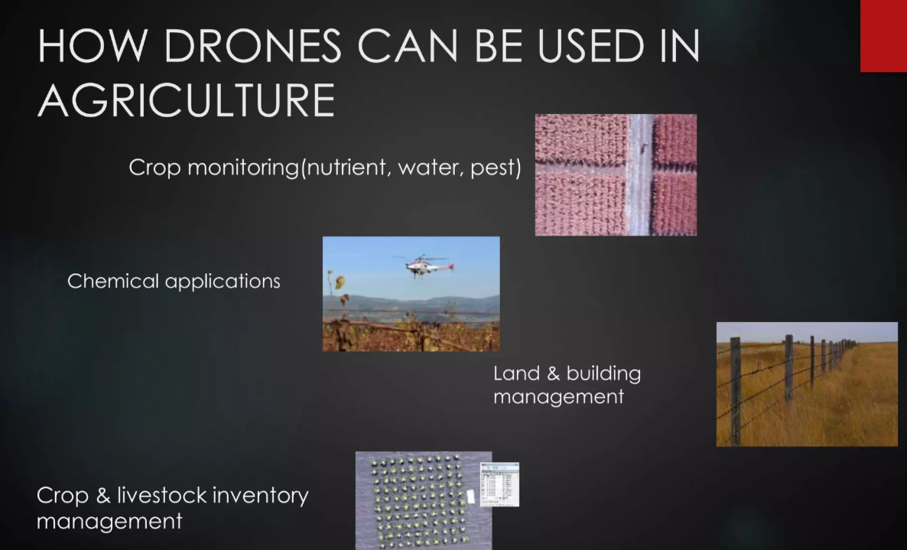
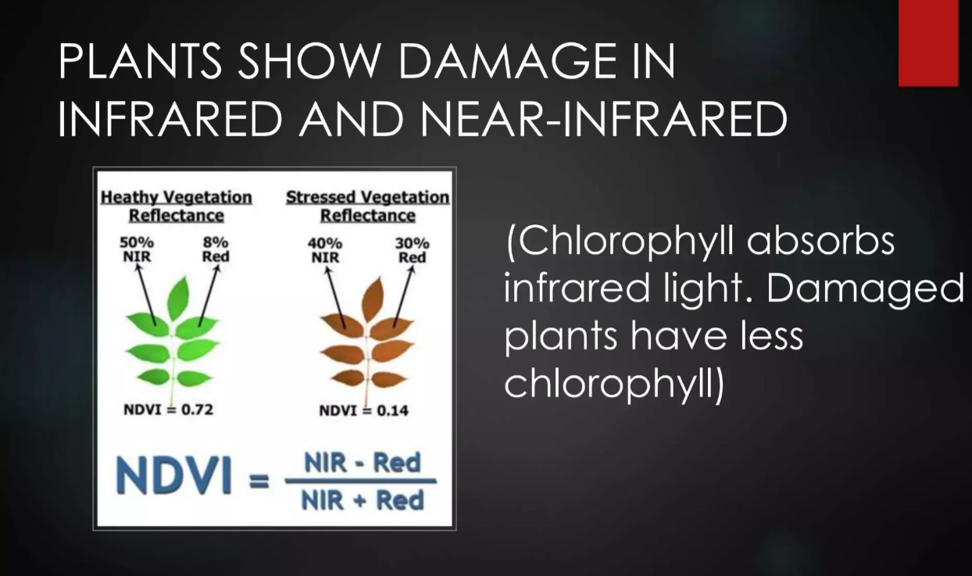
Process flow diagram or Use-case diagram

Slide 6
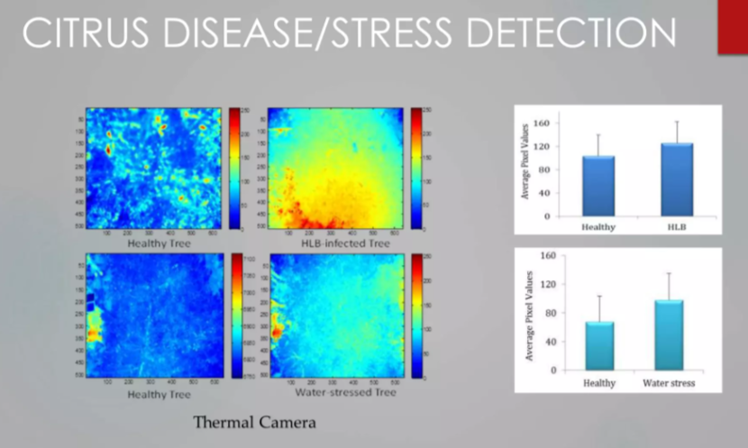
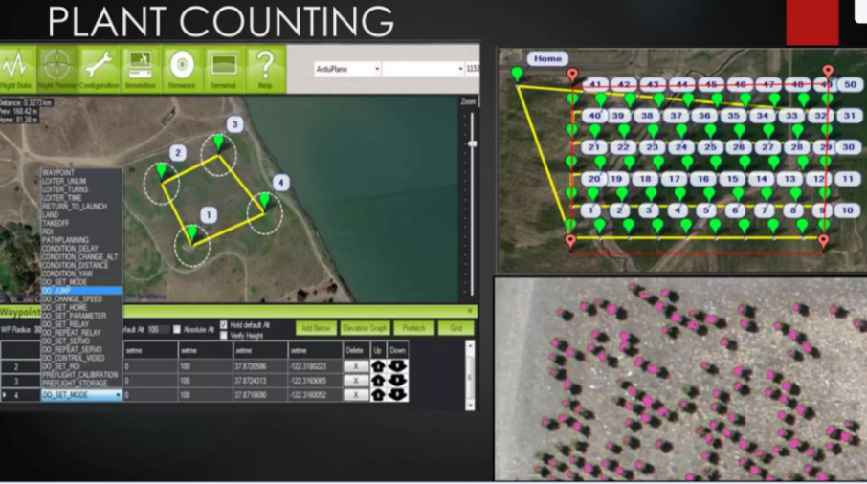
Wireframes/Mock diagrams of the proposed solution (optional)

Slide 7
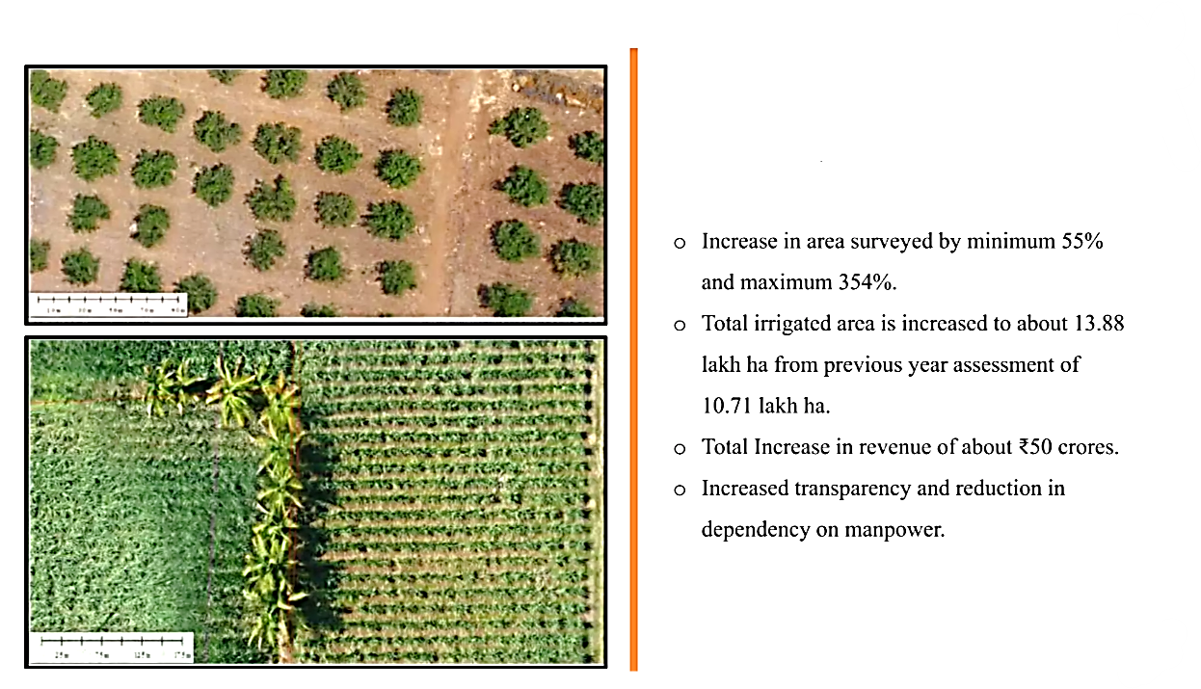
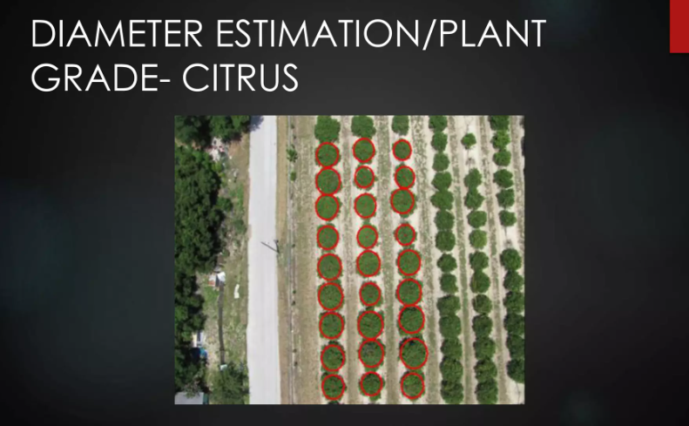
Architecture diagram of the proposed solution

Slide 8
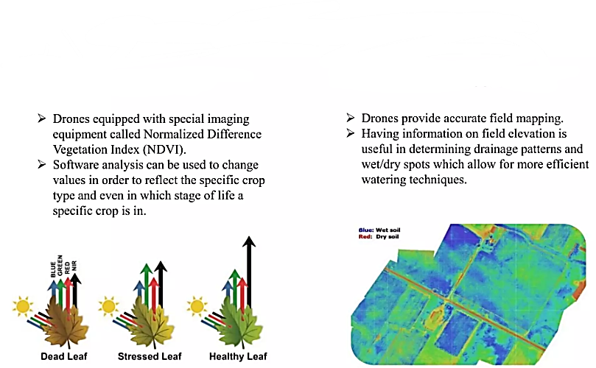
Monitoring Plant Health
Monitoring Plant Health
Monitoring Field Condition

Slide 9
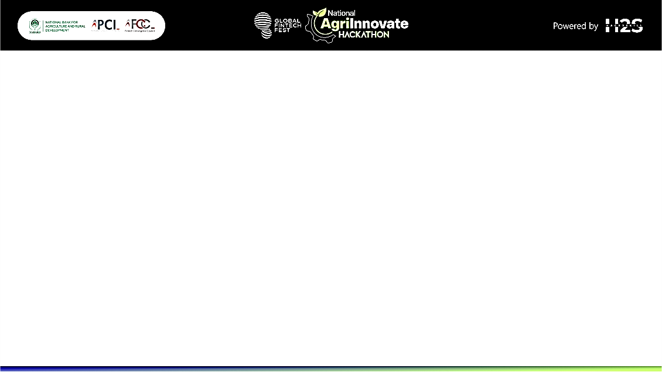
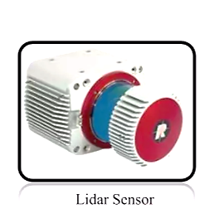
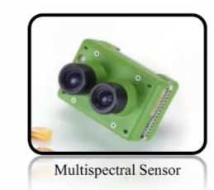
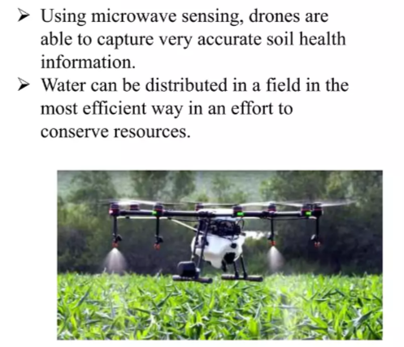
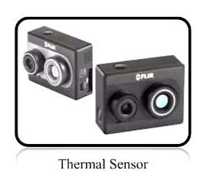
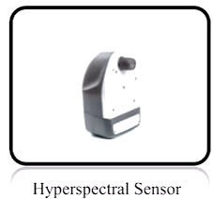
Technologies to be used in the solution
Drones Irrigation

Slide 10
MULTISPECTRAL SENSOR
They range in numbers of bands and resolution topping out under 1 cm per pixel. Multispectral Sensors are widely used in:
► Plant health measurement Water quality assessment
► Vegetation index
► Plant counting
THERMAL SENSOR
Most read Thermal sensors are best utilized in:
► Heat signature detection
► Livestock detection Most read Surveillance and security
► Water temperature detection and water source detection
► Emergency response
LIDAR SENSOR
Short range, 270° scanning LASER rangefinder Useful in 3D digital surface modelling stockpile calculation
► Surface variation detection and flood mapping
► Penetrates through vegetation: It can perform plant height measurement by collecting range information from the plant canopy and the ground below (as opposed to the passive optical imagers that provide height data from the canopy)
HYPERSPECTRAL SENSOR
Hyper spectral sensors are widely used in:
► Plant health measurement
► Water quality assessment
► Vegetation index calculation Full spectral sensing
► Spectral research and development
► Mineral and surface composition surveys

Slide 11
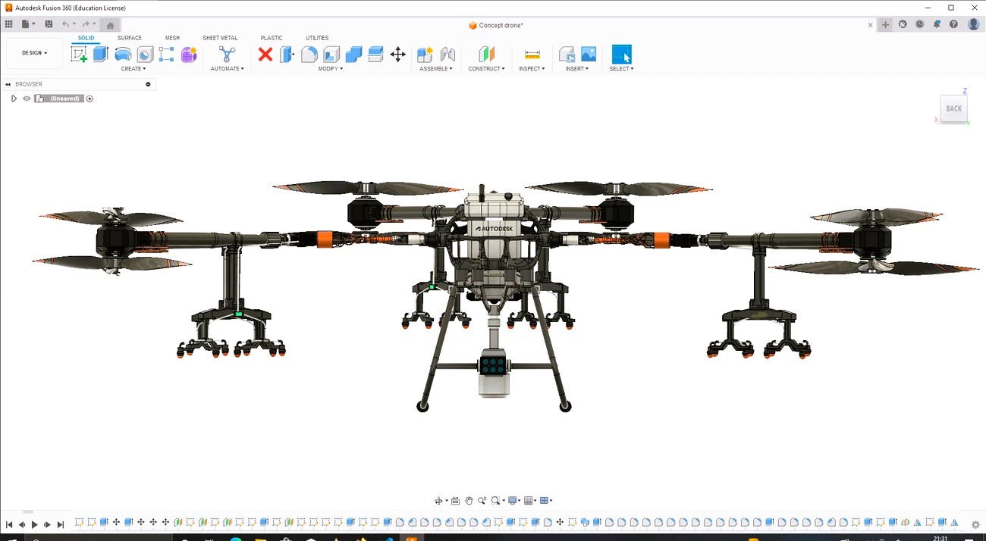
Snapshots of the prototype

Slide 12
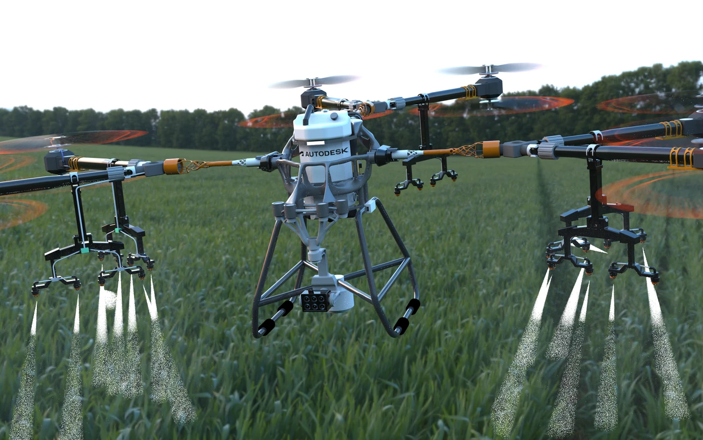
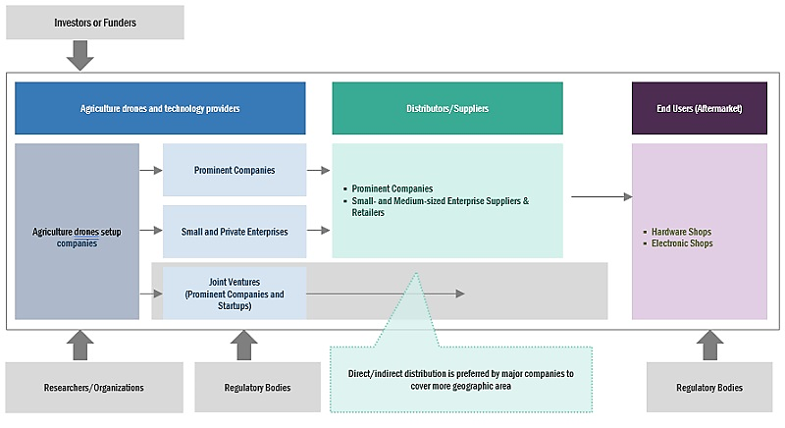
Prototype Performance report/Benchmarking

Slide 13
Additional Details/Future Development (if any)
Future development of this drone-based agricultural solution could include the integration of AI for predictive analytics, enabling even more precise input application and early detection of crop diseases. Expanding drone capabilities to include multispectral imaging and advanced sensors could further enhance crop monitoring and health assessments. Additionally, developing autonomous drone swarms could increase coverage area and efficiency, making the technology accessible to smaller farms. Collaborations with tech companies and research institutions could drive continuous innovation, ensuring the system evolves with emerging agricultural challenges and opportunities.

Slide 14
Provide links to your:
GitHub Public Repository
Demo Video Link (3 Minutes)
Final Product Link

Slide 16
